Slide 1
Remote web-based monitoring of the brewing process
Progress Presentation by Matthew King

Slide 2
Aim and objectives
Main Aim
Produce a system that can be used to monitor the brewing process remotely from a web page via a temperature sensor and a web enable camera
Objectives
Working temperature acquisition system
Raspberry Pi setup for data acquisition from the Arduino system
Completed automatically updating web page and integrated web camera
Completed automatically updating web page with video feed
Completed web page is hosted locally
Completed web page with a working web server solution and port forwarding
To create a light source for the camera that will automatically switch on in dark environments.
To create an email-based update system to notify the user of impending changes that need to be made or problems that need solving time permitting an SMS system could be implemented also.

Slide 3
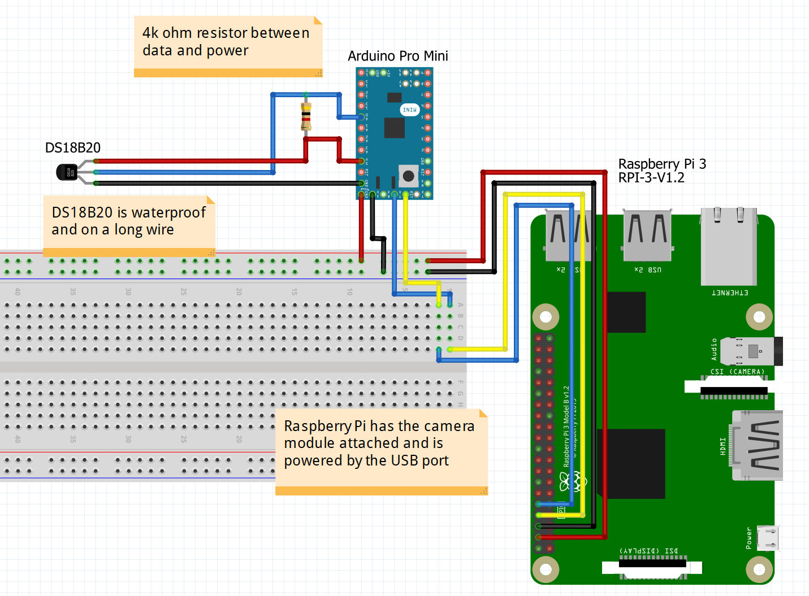
Current State Of the project

Slide 4
Current State Of the project
Building is ahead of Schedule

